Slide 1
CSE 325: Information System Design
Week 1: Requirement Analysis
Novia Nurain

Slide 2
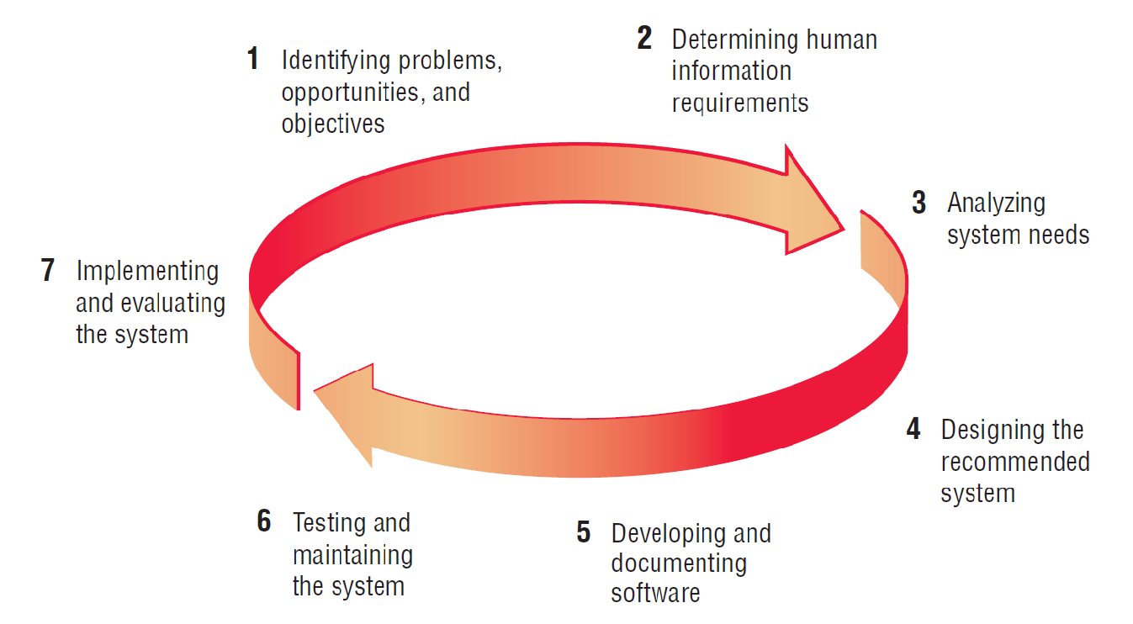
Systems Development Life Cycle (SDLC)
The systems development life cycle is a phased approach to solving business problems

Slide 3
What is a Requirement?
A requirement is a statement that describes:
- needs,
- behaviors, or
- conditions that a system must satisfy to solve a problem or achieve a goal.
It may range from a high-level abstract statement of a service or of a system constraint to a detailed mathematical functional specification.

Slide 4
Roles of Requirement
Customers
show what should be delivered; contractual base
Managers
a scheduling / progress indicator
Designers
provide a spec to design
Programmers
list a range of acceptable implementations/output
QA / testers
a basis for testing, validation, verification

Slide 5
Sources of Requirement
Stakeholders
Documentation review
Existing systems and processes
Regulatory or compliance guidelines

Slide 6
Stakeholders
Any person or group who will be affected by the system, directly or indirectly
Examples
End users
System administrators
Engineers maintaining the system
Business managers

Slide 7
Stakeholders’ Viewpoints
Different set of requirements for different types of stakeholders
Interactor viewpoints
People who interact with the system
Indirect viewpoints
People who influence the system’s requirements in some other way
Domain viewpoints
Domain characteristics and constraints

Slide 8
Stakeholders’ Viewpoints: Bank ATM
Interactor viewpoints
Consumer
Bank manager (policy settings)
People who fill up the ATM
Bank server
Indirect viewpoints
Bank manager (policy settings)
Federal reserve
Thieves or security managers
Domain viewpoints
Laws governing ATM use
Agreements with other banks

Slide 9
Types of Requirement?
User requirements: They describe what users want to achieve with the system in natural language, from the user’s point of view.
They focus on users’:
goals
needs
tasks
expectations
pain points
They do NOT describe technical details.

Slide 10
Types of Requirement?
System requirements: They describe what the system must do and how it must do it in technical, detailed terms.
They translate user goals into:
Functional requirements
Non-functional requirements
Constraints
Technical specifications
System requirements are more detailed, precise, and measurable.

Slide 11
User requirements = WHAT
What the user wants.
System requirements = HOW
How the system will fulfill the user’s wants.

Slide 12
Example
User Need: “I want to track my expenses.” User Requirement: The User should be able to record daily expenses System Requirements:
The system shall allow the entry of the amount and category.
The system shall store the record in a database.
The system shall show monthly summaries.

Slide 13
Types of Requirement?
Functional requirements: They describe what the system should do, the actions, behaviors, and features the information system must perform
Example 1: Library Management System
The system must allow a user to search for books by title, author, or ISBN.
The system must allow librarians to update book availability.
Example 2: Online Food Delivery App
The system must recommend restaurants based on the user’s location.
The system must allow users to track their delivery in real time.

Slide 14
Types of Requirement?
Non-Functional requirements: They describe how the system should behave, not what it must do.
They define qualities, constraints, and standards that the system must satisfy.
Non-functional requirements often apply to a whole system rather than individual features, such as performance, security, usability, availability, scalability, reliability, etc.

Slide 15
Examples
1. Performance NFR
The system must load the dashboard within 2 seconds for 90% of requests.
A food-delivery app must process restaurant search results in under 1 second.
2. Usability NFR
At least 85% of new users should complete account creation without training.
A health app’s interface must be readable for users aged 60+ using larger fonts.
3. Security NFR
All patient data must be encrypted using AES-256.
The system must auto-log out after 5 minutes of inactivity.

Slide 16
Examples
4. Availability NFR
Bank transaction system must be available 99.99% of the time.
Students must access the exam portal 24/7 during finals week.
5. Scalability NFR
The app must support 10,000 concurrent users without performance degradation.
A university portal must scale each semester as enrollment increases.
6. Reliability NFR
The video streaming service must resume playback automatically after interruptions.
System errors must not exceed 0.01% of total transactions per day.

Slide 17
What is Requirement Analysis?
Requirements analysis is the process of gathering, documenting, and analyzing the requirements for a project or product.
It is a crucial step in the software development process, as it helps to ensure that the final product will meet the needs of the end-users and stakeholders.

Slide 18
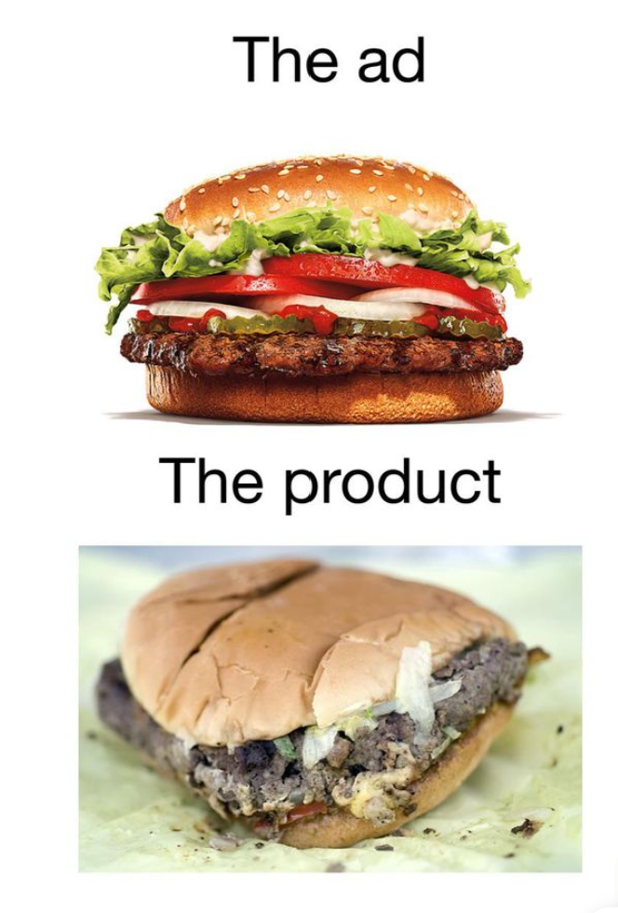
Why Requirement Analysis Matters?
Prevents system failure and misunderstandings
Reduces ambiguity in project scope
Ensures accurate design and implementation
Supports traceability throughout the development lifecycle
Allows the team to plan and prepare budget to address potential risks or issues

